Slide 1
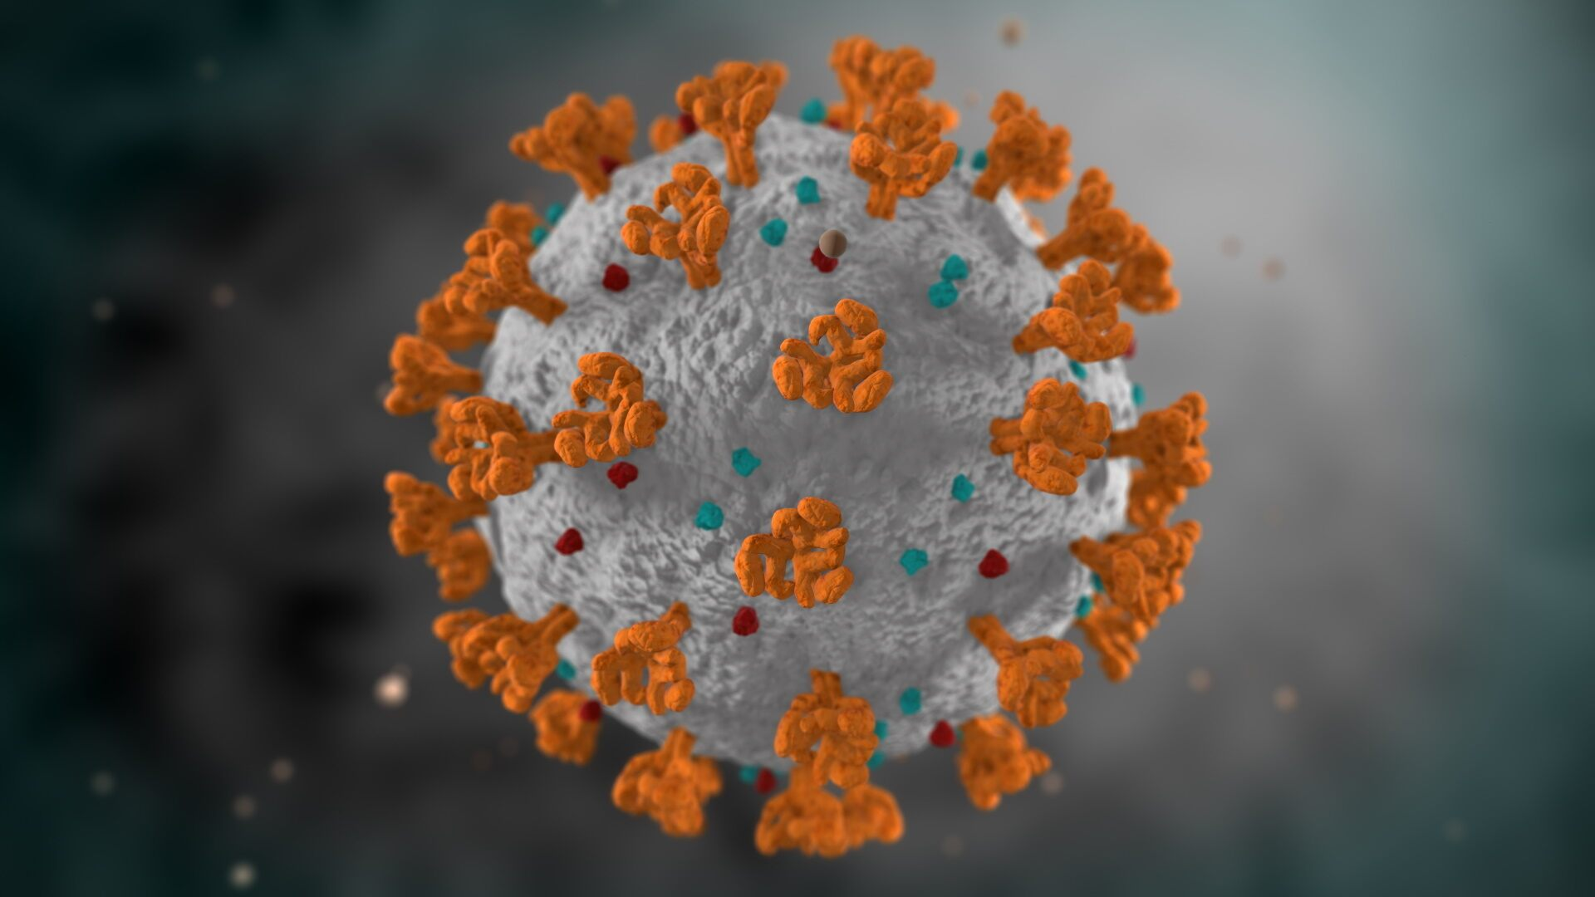
LAB MEETING

Slide 2
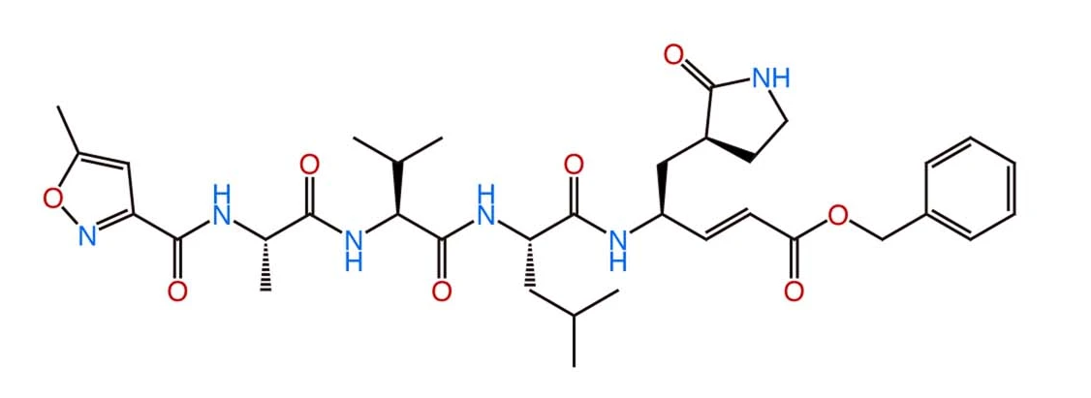
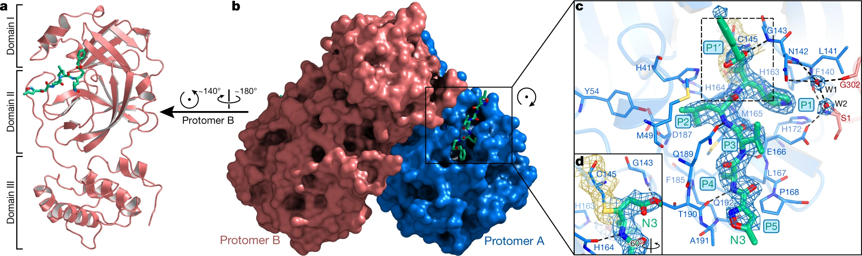
SARS-COV-2 M^{pro} Inhibitors
N3 is an irreversible inhibitor that can specifically inhibit M^{pro} from multiple coronaviruses, including SARS-CoV and MERS-CoV.
Jin, Z., Du, X., Xu, Y. et al. Structure of M^{pro} from SARS-CoV-2 and discovery of its inhibitors. Nature 582, 289–293 (2020). https://doi.org/10.1038/s41586-020-2223-y

Slide 3
SARS-COV-2 M^{pro} Inhibitors
PDB ID
6Y2G | Complex structure
6Y2F | Complex structure
6Y2E | Free protease
6LZE | In complex with 11a
6M0K | In complex with 11b
6WTJ | In complex with GC376
6WTK | In complex GC373
7BQY | In complex with N3
6LU7 | In complex with N3
7BUY | In complex with carmofur
Li, Q.; Kang, C. Progress in Developing Inhibitors of SARS-CoV-2 3C-Like Protease. Microorganisms 2020, 8, 1250.

Slide 4
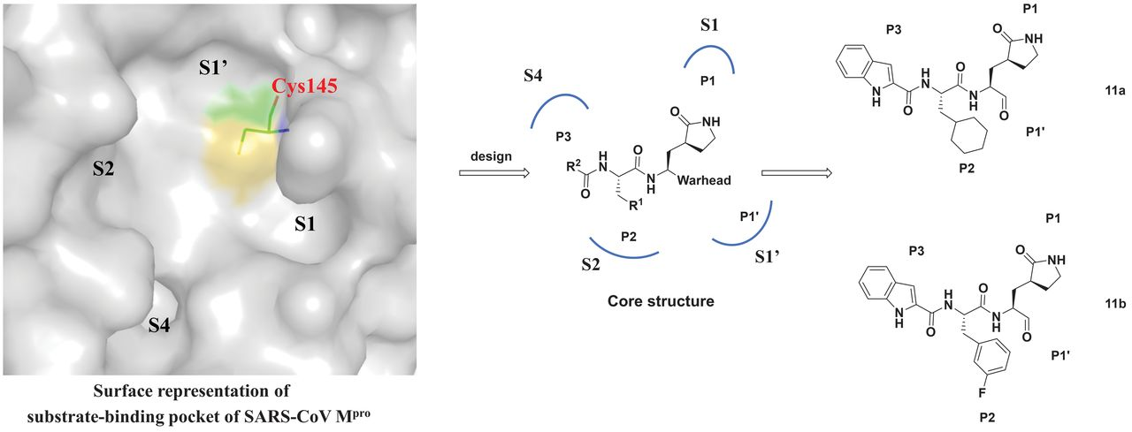
SARS-COV-2 M^{pro} Inhibitors
Li, Q.; Kang, C. Progress in Developing Inhibitors of SARS-CoV-2 3C-Like Protease. Microorganisms 2020, 8, 1250.

Slide 5
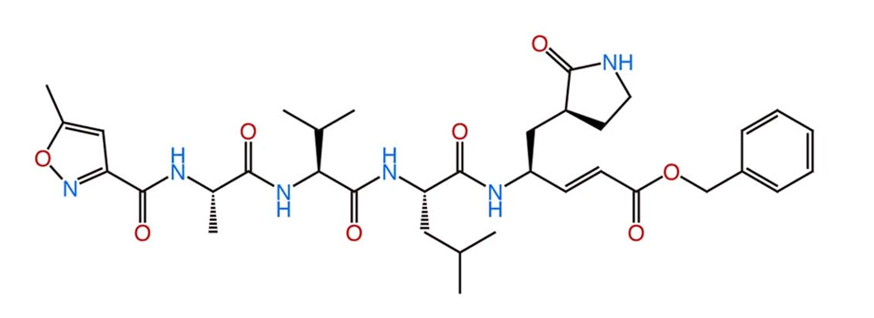
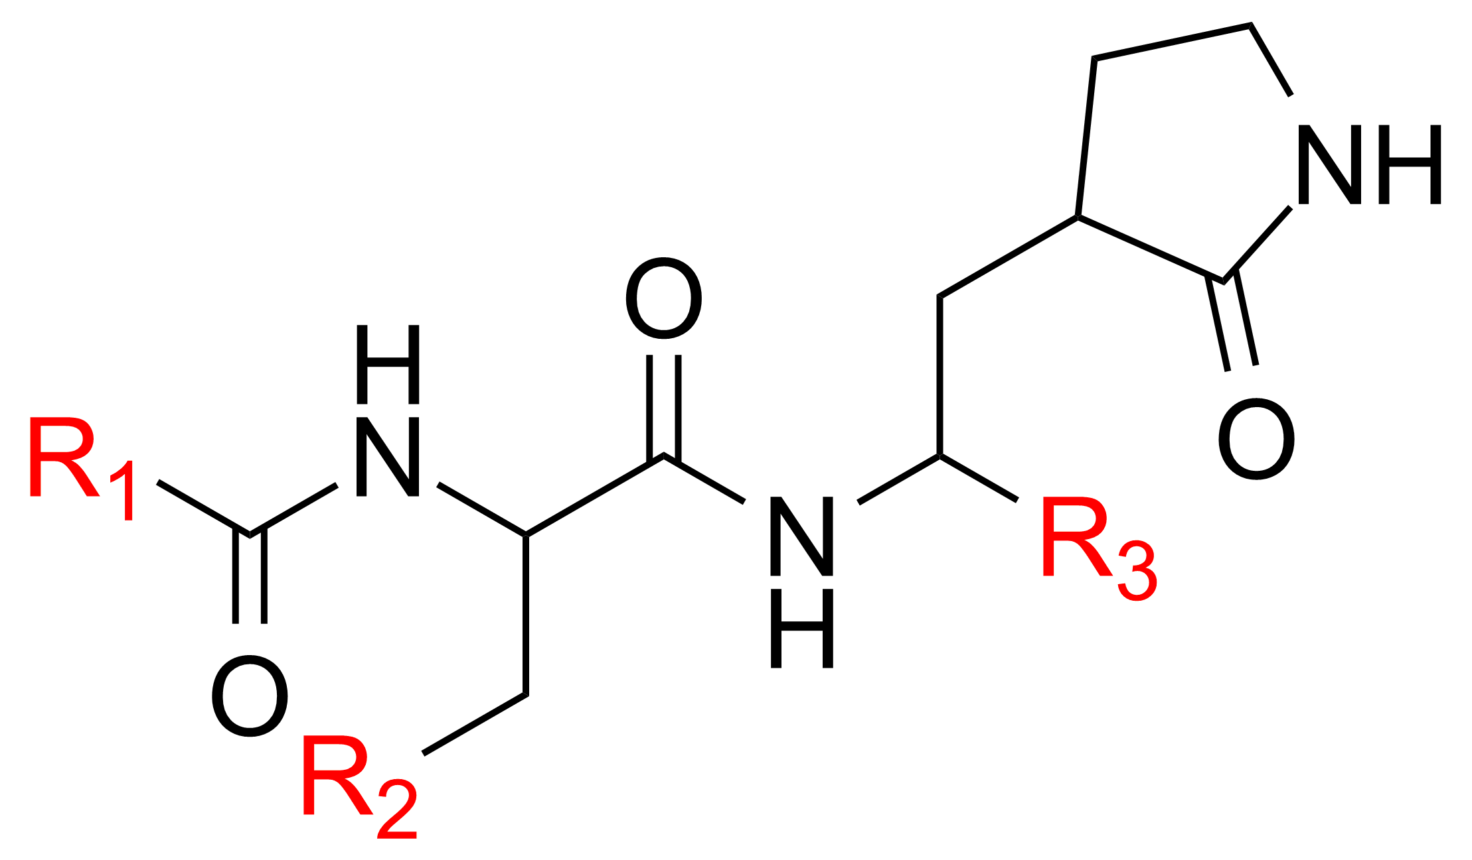
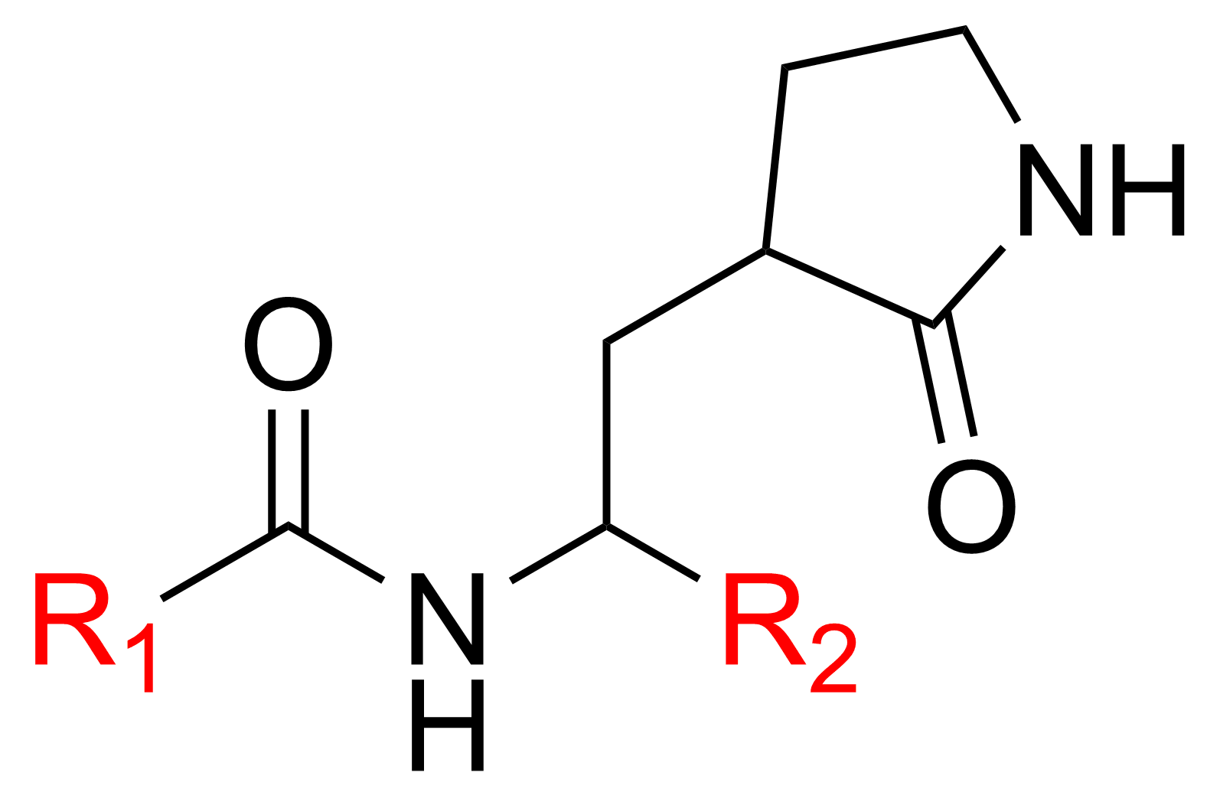
Project 1: Discovery New M^{pro} Inhibitors
Virtual screening
526 compounds from CHEMBL database
Superposition of all published M^{pro} crystal structures
Searching for ligand similarity

Slide 6
Project 1: Discovery New M^{pro} Inhibitors
10% Top scoring compounds
Binding pose analysis
MD simulations
(100 ns)
Candidate compounds
MM-PBSA calculations

Slide 7
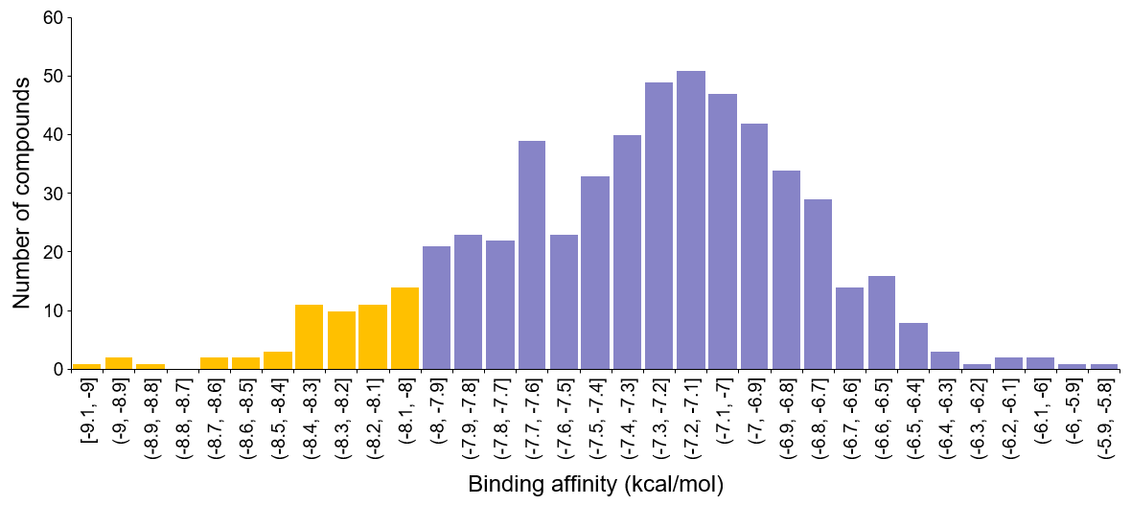
Project 1: Discovery New M^{pro} Inhibitors
52 compounds
(10% top hit ligands)
Cut-off

Slide 8
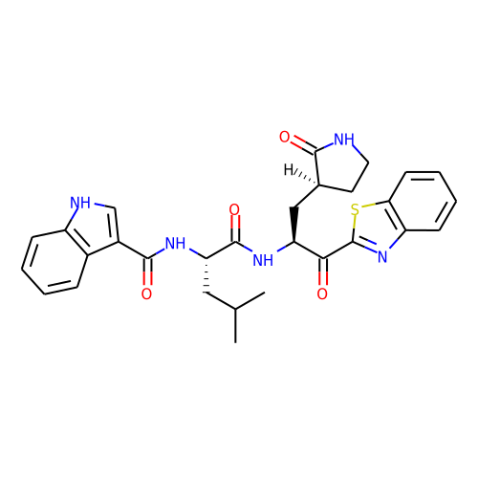
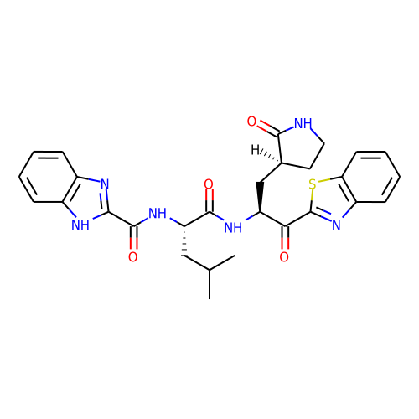
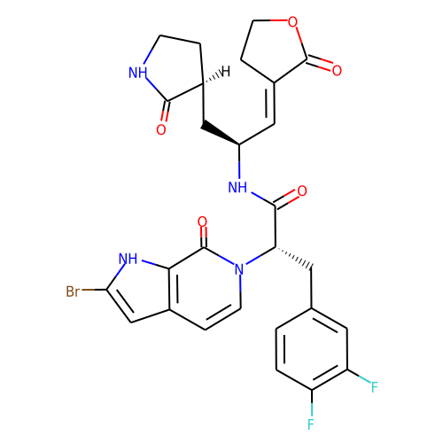
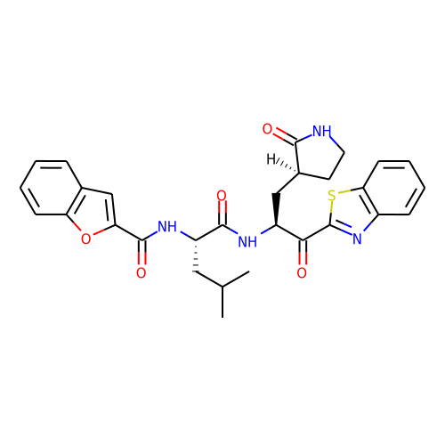
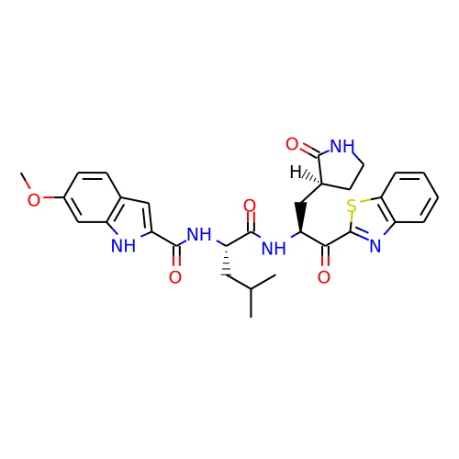
Project 1: Discovery New M^{pro} Inhibitors
Compound 1
(CHEMBL2435609)
Binding affinity = -8.9 kcal/mol
Compound 3
(CHEMBL2435605)
Binding affinity = -8.5 kcal/mol
Compound 2
(CHEMBL3813992)
Binding affinity = -8.9 kcal/mol
Compound 4
(CHEMBL2435608)
Binding affinity = -8.4 kcal/mol
Compound 5
(CHEMBL2435613)
Binding affinity = -8.3 kcal/mol

Slide 9
Project 1: Discovery New M^{pro} Inhibitors
M^{pro} without ligand
M^{pro}–Compound 1
M^{pro}–N3
M^{pro}–Compound 5

Slide 10
Project 1: Discovery New M^{pro} Inhibitors
Mpro-N3
E47-N51
E47-N51
R222
R222

Slide 11
Project 1: Discovery New M^{pro} Inhibitors
Mpro-Compound 1
R222
Y154
R222

Slide 12
Project 1: Discovery New M^{pro} Inhibitors
Mpro-Compound 5
E47-P52
R222
E47-P52
Y154
R222

Slide 13
Project 1: Discovery New M^{pro} Inhibitors
Compound | Energy (kcal/mol)
Compound | ΔE_{vdW} | ΔE_{elec} | ΔE_{MM} | ΔG_{polar} | ΔG_{apolar} | ΔG_{total} | ΔG_{exp}
N3 (Reference) | -55.855±5.274 | -16.195±3.907 | -72.050±7.451 | 51.219±6.079 | -6.088±0.410 | -26.919±3.757 | -6.552
Cpd1 | -51.273±4.251 | -15.805±2.765 | -67.078±5.428 | 50.375±3.903 | -5.259±0.312 | -21.962±3.960 | -
Cpd2 | - | - | - | - | - | - | -
Cpd3 | - | - | - | - | - | - | -
Cpd4 | - | - | - | - | - | - | -
Cpd5 | -50.617±3.609 | -12.126±2.516 | -62.743±4.801 | 42.758±12.937 | -5.358±0.275 | -25.343±11.662 | -

